Slide 1

SQL- Supermarket analysis
Project objective:
The main goal of this project is to analyze historical sales data from a supermarket company, with a specific emphasis on creating a MySQL database. This database will facilitate the exploration of trends and insights in three key areas:
Sales analysis
Customer segmentation
Predictive analytics
Data source:
Data is taken from kaggle.com and has been recorded for three branches over 3 months Jan 2019, Feb 2019 and Mar 2019.
Link: https://www.kaggle.com/datasets/aungpyaeap/supermarket-sales

Slide 2
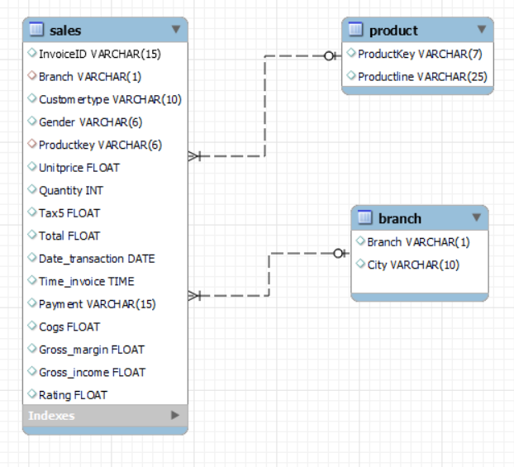
Schema design:
The dataset is in single sheet, but I define three table as part of the schema sales, product and branch to add more complexity in the analysis.
Product to sales relationship is one to many using primary key as productKey.
Branch to sales relationship is one to many using primary key as branch.
System used for this analysis MySQL.

Slide 3
Question-1: Retrieve the total sales for each branch ?
Query:
select branch , round(sum(total),0) as total_sales
from sales
group by branch
order by total_sales desc;
Output:
Question-2: Calculate the average rating for each product line ?
Query:
select p.productline, round(avg(s.rating),2) as avg_ratingfrom
sales as s join product as p on s.productkey = p.productKey
group by p.productline
order by p.productline;
Output:
branch | total_sales
A | 103725
C | 102772
B | 101602
productline | avg_rating
Electronic accessories | 6.92
Fashion accessories | 7.03
Food and beverages | 7.11
Health and beauty | 7.00
Home and lifestyle | 6.84
Sports and travel | 6.92

Slide 4
Question-3: Find the total gross income for each month in 2019 ?
Query:
select monthname(date_transaction) as month_of_year, sum(gross_income)
from sales
group by month_of_year;
Output:
Question-4: Identify the top 5 products with the highest gross income ?
Query:
select p.productline, s.productkey, sum(s.gross_income) as gross_income
from sales s
inner join product p on s.productkey = p.productKey
group by p.productline, s.productKey
order by gross_income desc
limit 5;
Output:
month_of_year | sum(gross_income)
January | 31862.62
March | 30051.85
February | 26244.43
productline | productkey | gross_income
Electronic accessories | EA101 | 15743.50
Food and beverages | FB202 | 14906.74
Sports and travel | ST404 | 14809.86
Home and lifestyle | HL303 | 14481.50
Fashion accessories | FA102 | 14293.48

Slide 5
Question-5: Calculate the total tax amount collected for each payment method ?
Query:
select payment, round(SUM(tax5),0) as tax_collected
from sales
group by payment;
Output:
Question-6: What is the gender distribution of customers for each branch ?
Query:
with genderDistribution as
(
select branch, gender, count(*) genderCount
from sales
group by branch, gender
order by branch)
payment | tax_collected
Ewallet | 5254
Cash | 5357
Credit card | 4812

Slide 6
select branch, gender, genderCount,
round((genderCount*100) / sum(genderCount) over (partition by branch), 2) as percentage
from genderDistribution
order by branch, gender;
Output:
Question-7: How does the gross margin percentage vary between Member and Normal customers ?
Query:
Select customertype, avg(gross_margin) as avg_margin, min(gross_margin) as min_margin, max(gross_margin) as max_margin
From sales
group by customertype;
branch | gender | genderCount | percentage
A | Female | 161 | 47.35
A | Male | 179 | 52.65
B | Female | 162 | 48.80
B | Male | 170 | 51.20
C | Female | 178 | 54.27
C | Male | 150 | 45.73

Slide 7
Output:
Question-8: Are there any seasonal trends in sales based on the date and time of the purchases ?
Query:
Select monthname(date_transaction) as mth, ROUND(sum(total),0) as total_sales
From sales
group by MTH
order by MTH;
Output:
Question-9: Which branch has the highest average total sales per month in 2019 ?
customertype | avg_margin | min_margin | max_margin
Member | 0.229540923 | 0.2 | 0.4
Normal | 0.233266538 | 0.2 | 0.4
mth | total_sales
February | 93134
January | 109024
March | 105940

Slide 8
Query:
with t1 as
(
--- monthly average sale
select mth, round(avg(total_sales),0) as averagebymonth
From
(select branch, monthname(date_transaction) as mth, sum(total) as total_sales
from sales
group by branch, mth) x
group by mth),
--- monthly branch wise sale
t2 as
(select branch, monthname(date_transaction) as month_name, round(sum(total),0) as total_monthly_sales
from sales
group by branch, month_name)
--- compare average and monthly sales
select *
from t2
join t1 on t2.total_monthly_sales > t1.averagebymonth
where month_name = mth
order by averagebymonth desc;
Output:
branch | month_name | total_monthly_sales | mth | averagebymonth
A | January | 38460 | January | 36341
C | March | 36649 | March | 35313
A | March | 36605 | March | 35313
B | February | 34107 | February | 31045

Slide 9
Question-10: Find the total revenue generated by Male and Female customers for each product line ?
Query:
--- total revenue generated by each product line
select s.gender, p.productline as product_name, round(sum(s.total),0) as total_revenue
from sales as s
join product as p on s.productkey = p.productKey
group by gender, product_name;
--- total revenue and gender contribution for each product line revenue
with total_revenue_table as ( --- total revenue by gender and product line
select s.gender, p.productline as product_name, round(sum(s.total),0) as total_revenue
from sales as s
join product as p on s.productkey = p.productkeygroup by gender, product_name)
---gender contribution for each individual product line
select gender, product_name, total_revenue,round((total_revenue * 100) / sum(total_revenue) over (partition by product_name),2) as cont_percentage
from total_revenue_table
order by product_name;
Output:
gender | product_name | total_revenue | cont_percentage
Female | Electronic accessories | 26708 | 50.26
Male | Electronic accessories | 26436 | 49.74
Female | Fashion accessories | 28256 | 55.81
Male | Fashion accessories | 22372 | 44.19
Female | Food and beverages | 31855 | 58.70
Male | Food and beverages | 22412 | 41.30
Female | Health and beauty | 17885 | 37.24
Male | Health and beauty | 30141 | 62.76
Male | Home and lifestyle | 21265 | 43.72
Female | Home and lifestyle | 27376 | 56.28
Male | Sports and travel | 26205 | 49.08
Female | Sports and travel | 27187 | 50.92

Slide 10
Question-11: Determine the peak hours of sales for each branch ?
Query:
select branch, hour(time_invoice) as purchase_time, count(*) as no_of_order
from sales
group by branch, purchase_time
order by purchase_time;
Output:
branch | purchase_time | no_of_order
A | 10 | 38
A | 11 | 35
A | 12 | 33
A | 13 | 31
A | 14 | 25
A | 15 | 37
A | 16 | 32
A | 17 | 27
A | 18 | 33
A | 19 | 27
A | 20 | 22
branch | purchase_time | no_of_order
B | 10 | 26
B | 11 | 33
B | 12 | 25
B | 13 | 38
B | 14 | 30
B | 15 | 32
B | 16 | 17
B | 17 | 20
B | 18 | 35
B | 19 | 50
B | 20 | 26
branch | purchase_time | no_of_order
C | 10 | 37
C | 11 | 22
C | 12 | 31
C | 13 | 34
C | 14 | 28
C | 15 | 33
C | 16 | 28
C | 17 | 27
C | 18 | 25
C | 19 | 36
C | 20 | 27

Slide 11
Question-12: Calculate the month-over-month growth rate in net income for each branch ?
Query:
select branch, monthNumber, netIncome,(netIncome - lag(netIncome) over(partition by branch order by monthNumber)) / lag(netIncome) over(partition by branch order by monthNumber) * 100 as growthRatefrom
(select branch, month(date_transaction) as monthNumber, sum((total-tax5)) as netIncome
from sales
group by branch, monthNumber
order by monthNumber) monthlyNetIncome;
Output:
branch | monthNumber | netIncome | growthRate
A | 1 | 36612.66 | NULL
A | 2 | 27233.69 | -25.62
A | 3 | 34806.08 | 27.81
B | 1 | 33035.05 | NULL
B | 2 | 32463.10 | -1.73
B | 3 | 31032.51 | -4.41
C | 1 | 33823.87 | NULL
C | 2 | 28794.59 | -14.87
C | 3 | 34873.03 | 21.11

Slide 12
Insight derived from the analysis!
1).The highest cumulative sales were achieved by A, C, and B
2).The highest gross income was recorded in January, followed by February and March.
3).The product line with the highest average rating is Food and Beverage, followed by Fashion Accessories and
then Health and Beauty.
4).Among the six distinct product lines, the top three are Electronic Accessories, Food and Beverages, and Sports
and Travel.
5).The most frequently used payment methods are eWallet, cash, and credit card.
6).Branches A and B have a higher male contribution, while Branch C has a higher female contribution.
7).The gross margin is equal for both member and normal customer types.
8).Sales dropped in February due to a shorter month.
9).The median number of order remains consistent for each business hour.
10).Branch B experienced a slight negative month-over-month growth rate.

